Slide 1
ENGINEERING EXPLORATION GROUP PROJECT
BY AATMAJ MHATRE, OM KELKAR, UJJAWAL PATEL, SHUBHRAJA LALITH

Slide 2
Primary Objectives of the Project:
To develop a product that improves motor skills and hand eye coordination among disabled persons and toddlers.
Finished product should be battery operated to increase portability.
Product should be compact, around 30cm wide and 40cm long

Slide 3
Product Specifications
The product developed must help in development of hand eye coordination skills of the customer.
It should be an activity that is easy to handle , the setup should be portable and should not take up a lot of time.
It is necessary to develop a cost effective solution where we can manage the production and selling price.
The setup should be compact and easy to carry.
The solution must cater to the need of limited customers, I.e, disabled persons and toddlers.
The product helps in overall development of motor skills of the user via an interactive and simple interface. It is a brief activity of 5-10 minutes on a daily basis.
The setup does not emit harmful radiations and rays and is safe to use.

Slide 4
Literature Survey
A research was conducted on 78 children in the age group 8-10 using a similar mechanism. (https://www.sciencedirect.com/science/article/pii/S0167945716302974) Random numbers appeared on the screen and a keypad was used to enter the number. This exercise improved the manual dexterity scores of the children.
A very similar study on keyboard positions was conducted which proved increase in eye-hand coordination skills. (https://booksc.org/ireader/24159130)
Another study applies a similar principle of mole hitting for increasing the eye-hand coordination. It employes three methods for doing so. Mole hitting for random operations, balloon catching game for vertical movement, and the fish catching game for horizontal transfer. However this setup is very sophisticated, bulky and costly. (https://www.jstage.jst.go.jp/article/jrobomech/26/6/26_704/_pdf/-char/ja)
A recent study maps video games to development of eye hand coordination. (https://www.sciencedirect.com/science/article/abs/pii/S0039606020308199)

Slide 5
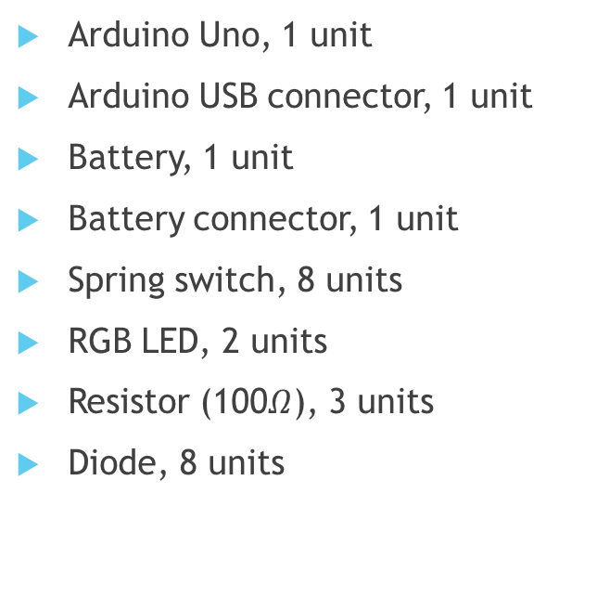
List of Components Required for the Project:
Wire, 1 unit, 30 cm long
Wire connector (M-M), 8 units
Wire connector (F-M), 3 units
Copper strip, 2 units, 25 cm long

Slide 6
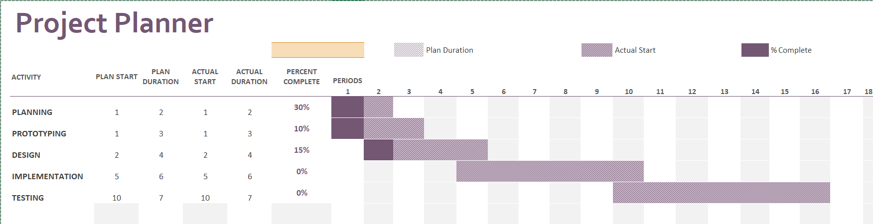
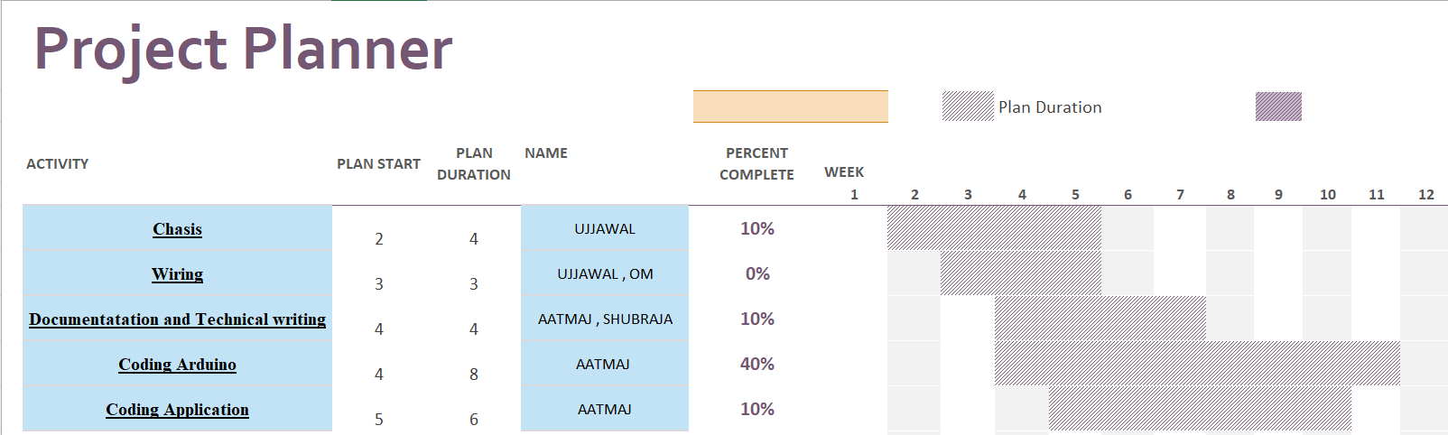
Timeline & Gantt Chart:

Slide 7
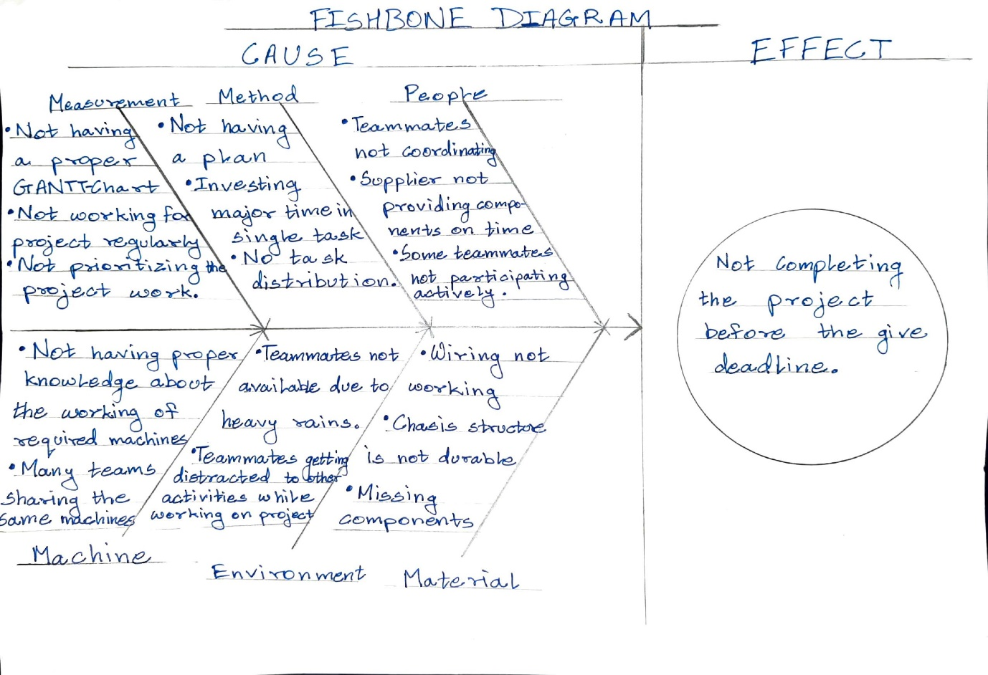
Fishbone Diagram

Slide 8
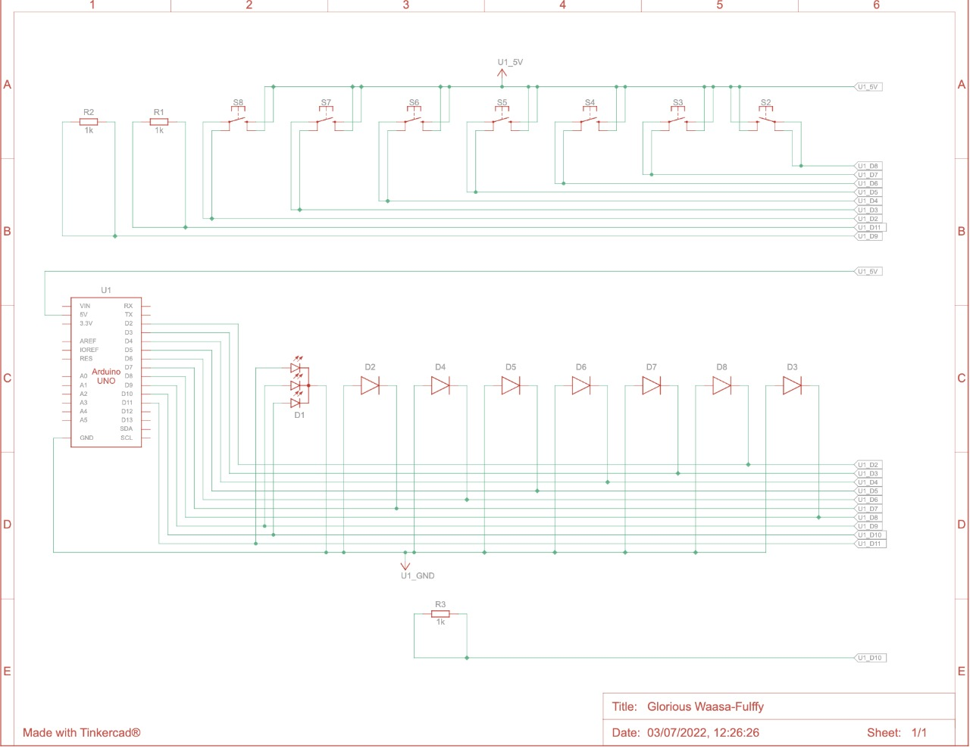
Circuit Diagram:

Slide 9
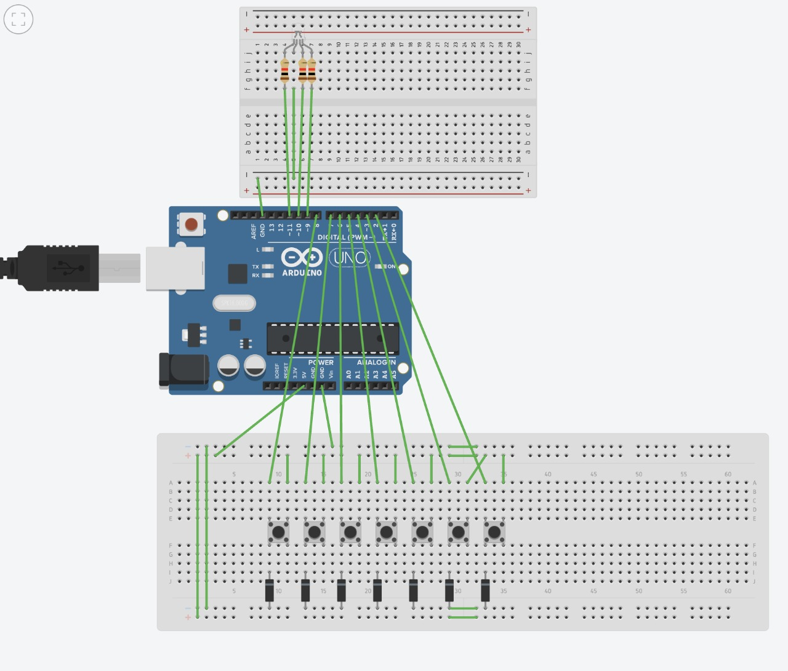
View in Tinkercad:

Slide 10
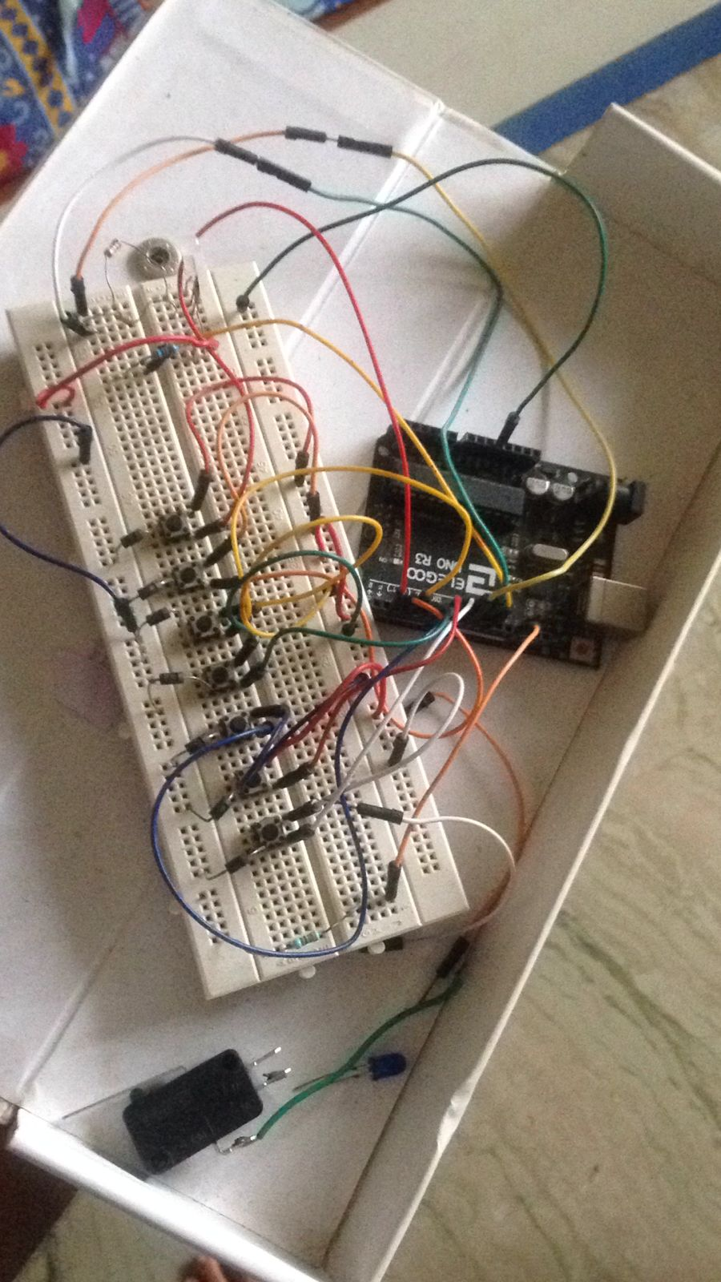
Prototype of product:

Slide 11
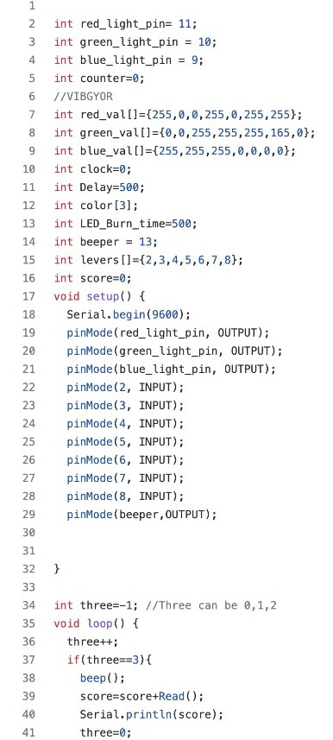

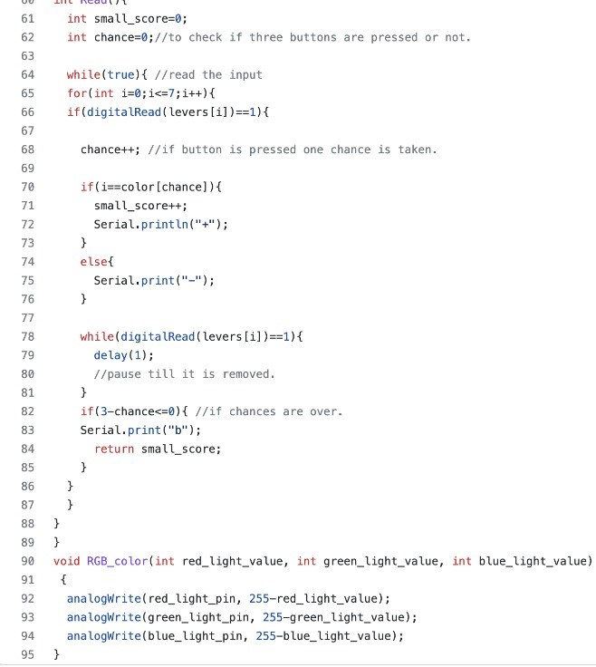
Screenshot of Code Required for Arduino:

